Slide 1
By Nilanjan Mitra
Car Sales For Specific EngType

Slide 2
Brief Story on Car Data Set
The cars are the most comfortable vehicles to travel from one location to another.
The cars are being used in most of the countries from year 1950,depends on the technology the cars are being developed in different ways of styles.
In our dataset, we have the cars registered from 1986 to 2016.
If we observe, the cars are made with different body types, engine types, drive and fuel type.
As the technology is growing, automobile industry has taken it's own path in research and development. Thus, it was made that cars came up with different fuel types like gas, petrol and diesel.
Even the engine speed levels has its priority on other side, which made the people to choose high speed car.
At the same time, the preference of comfortness changed like Sedan, Hatch, Crossover and Vagon.
It's people choice that they can choose the cars with different specifications.

Slide 3
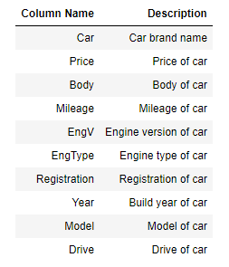
Data Loading and Description
The dataset consists of the information about different type of cars where various variables present in dataset includes price, body, mileage, type of engine, registration, build year, model and drive of car.
The dataset comprises of 9576 observations of 10 columns. Below is a table showing names of all the columns and description.

Slide 4
Problem Statement
The notebooks explores the basic use of Pandas and will cover the basic commands of Exploratory Data Analysis(EDA) which includes cleaning, munging, combining, reshaping, slicing, dicing and transforming data for analysis purpose.
Understand the data by EDA and derive simple models with Pandas as baseline.
EDA is a critical and first step in analysing the data and we do this for below reasons :
- Finding patterns in Data
- Determining relationships in Data
- Checking of assumptions
- Preliminary selection of appropriate models
- Detection of mistakes

Slide 5
Questionnaires
Of all the cars, how many cars has registration?
Which engType car has more drive option?
Which build year cars are more?
Which body engType are more?
Which body cars are more?
Comparison between mileage and price for all cars
Draw a pair plot to know the joint relationship between 'Price', 'Mileage‘ and 'Body'
Establish correlation between all the features using heat map
Hypothesis: Petrol Cars are more likely to be sold

Slide 6
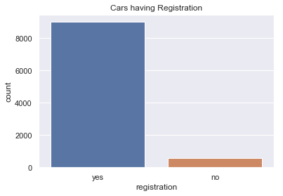
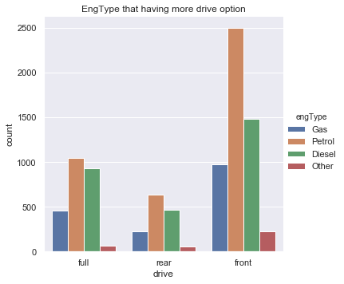
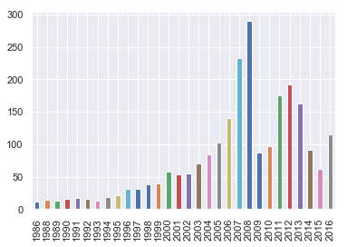
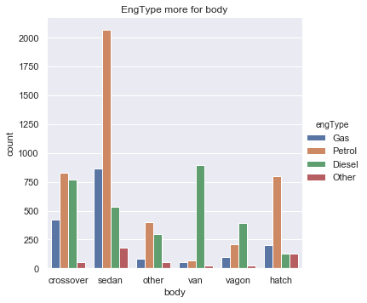
Objectives & Graphs

Slide 7
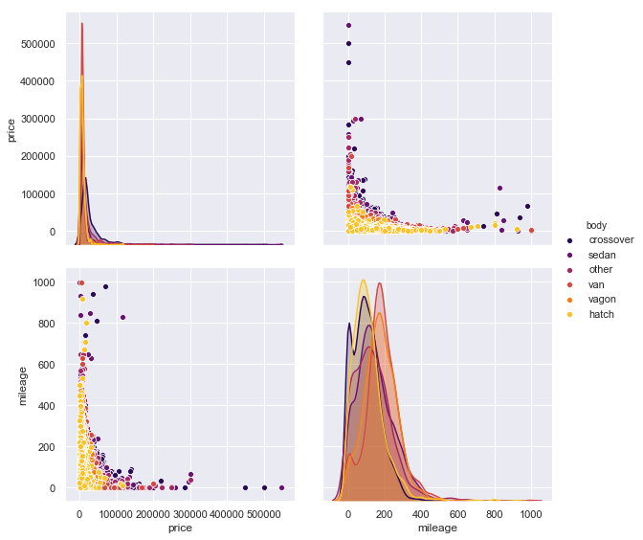
Objectives & Graphs

Slide 8
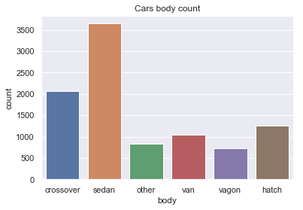
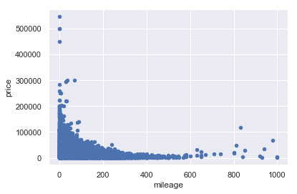
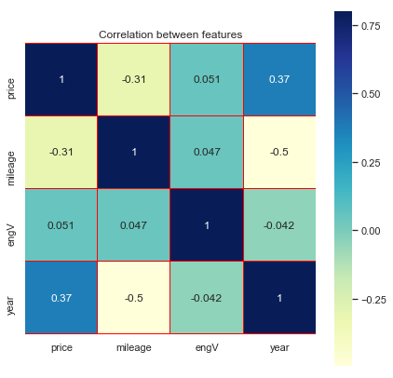
Objectives & Graphs

Slide 9
Conclusion
With the help of this notebook we learnt how exploratory data analysis can be carried out using Pandas plotting.
Also we have seen making use of packages like matplotlib and seaborn to develop better insights about the data.
We have also seen how pre-processing helps in dealing with missing values and irregularities present in the data.
We also make use of pandas profiling feature to generate html report containing all the information of the various features present in the dataset.
We have seen the impact of columns like Body,Mileage,engType,engV,drive and year on car price.
The most important inference drawn from all this analysis is, we get to know what are the features on which car price is highly positively and negatively correlated with.
This analysis will help us to choose which machine learning model we can apply to predict engType of car more likely to be sold.

